Slide 1
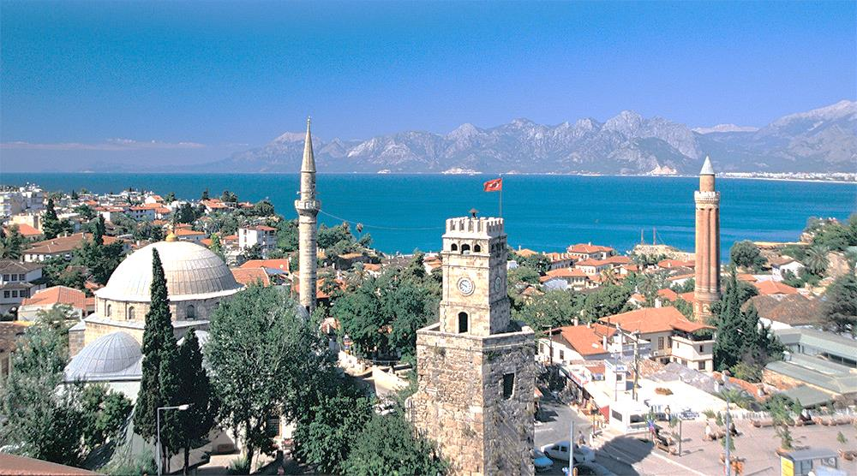
ANTALYA :
19 DISTRICTS
With a population of 2.364.396
population growth rate is 1.54%

Slide 2
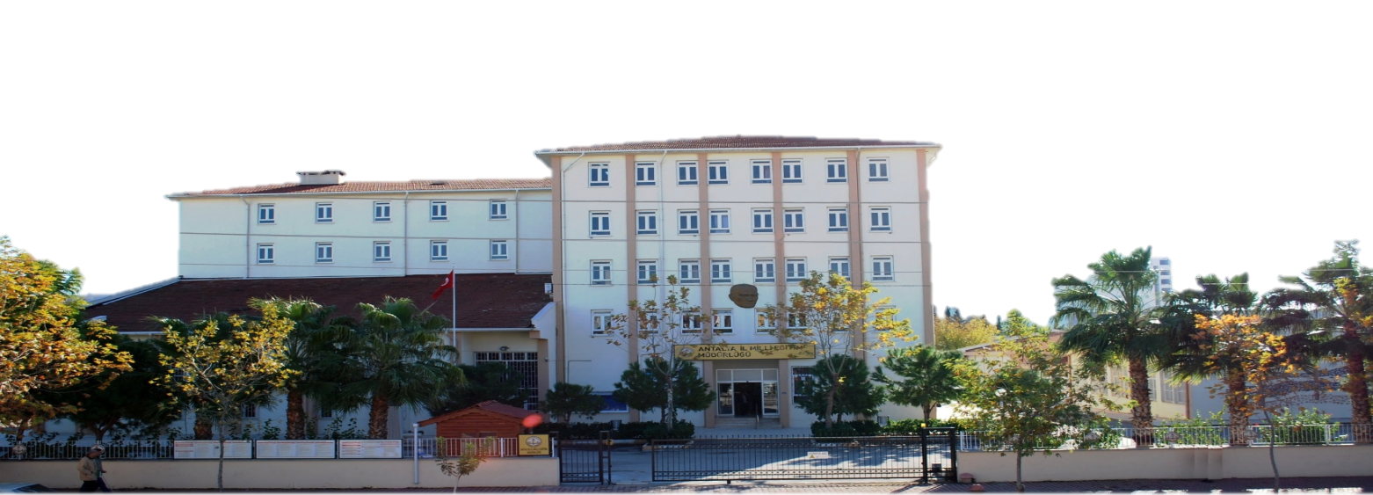
WITH the structure of our DIrectorate,
1 Manager, 6 Deputy DIrector, 10 Branch Manager, 45 Educaton Inspector, 13 TraInIng SpecIalIst, 5 Researchers together wIth a total of 373 personnel are workIng.

Slide 3
In addition, 981 personnel are employed in 71 institutions,
including 19 District National Education Directorates,
20 Public Education Centers, 11 Vocational Training Centers,
10 Teachers' Houses, 7 Guidance Research Centers,
1 Maturation Institute.

Slide 4
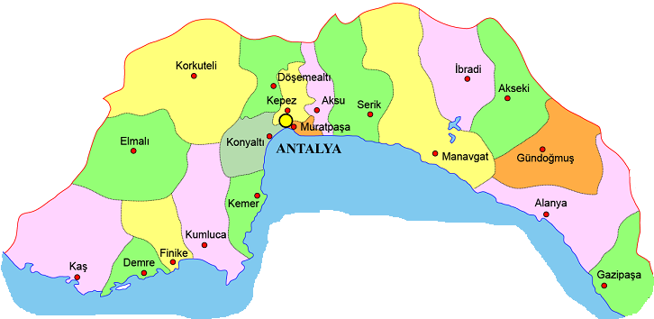
There are
1310 public schools ,376 Private schools (total 1686 schools) ,
16.795 public classrooms ,4.036 private classrooms (total 20,831classrooms)
25.982 State teachers, 5.759 5 private teachers (total 31.741 teachers)
406.839 state students, 44,817 private students (total 451,656 students)

Slide 5
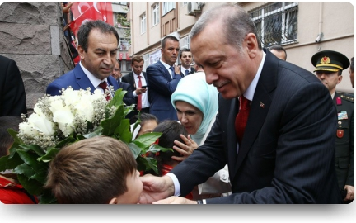
PRE-SCHOOL
In total, 57,684 students are studying in 2,437 classrooms, of which 4,173 in the 3 age group, 15,335 in the 4 age group, 38,186 in the 5 age group.
The number of students per class is 23.

Slide 6
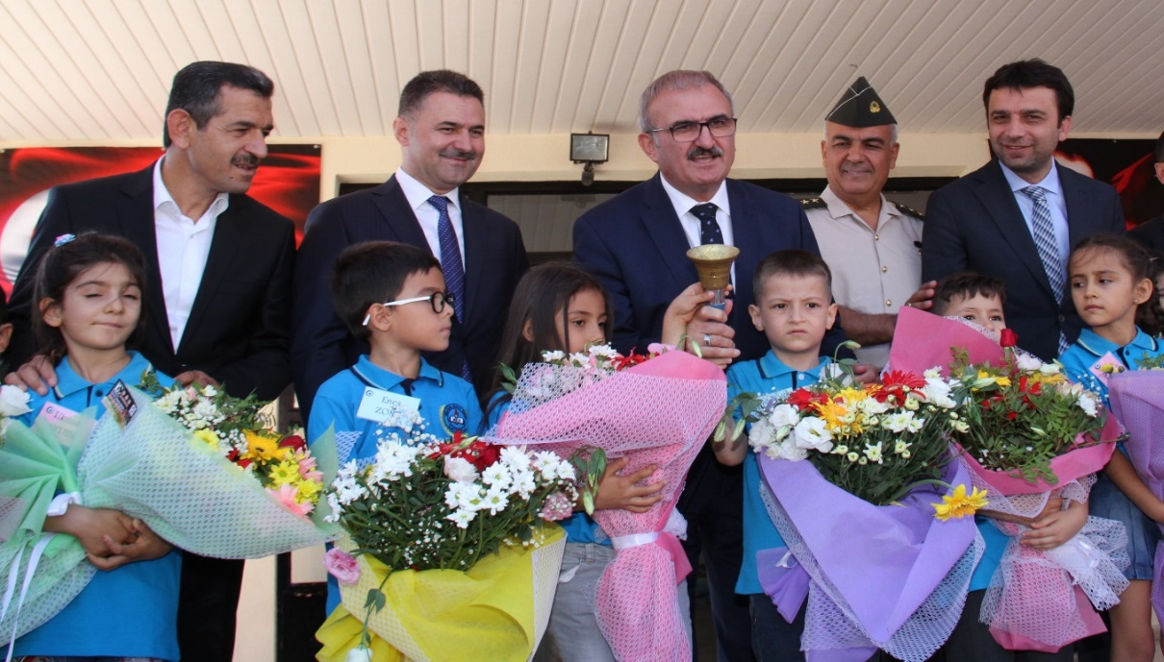
PRIMARY SCHOOL
In the provınce, 544 elementary schools, 135,518 students ın 7,221 classrooms, 7,634 wıth TEACHERS
The number of students per classroom in primary schools is 18, Primary school enrollment rate is 89,66%.

Slide 7
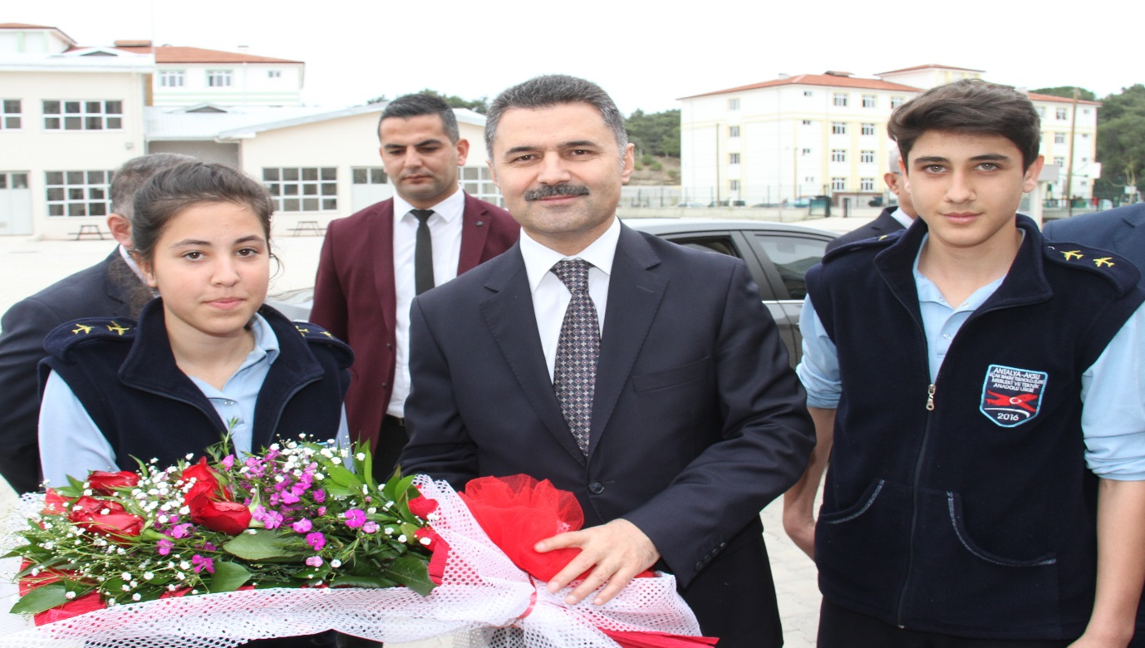
MIDDLE SCHOOL
As of the begInnIng of the 2018-2019 academIc year;
A total of 144,823 students are studyIng In 4,668 classrooms, wIth a total of 10,200 teachers. The number of students per classroom Is 31 and the schoolIng rate Is 93.54%.

Slide 8
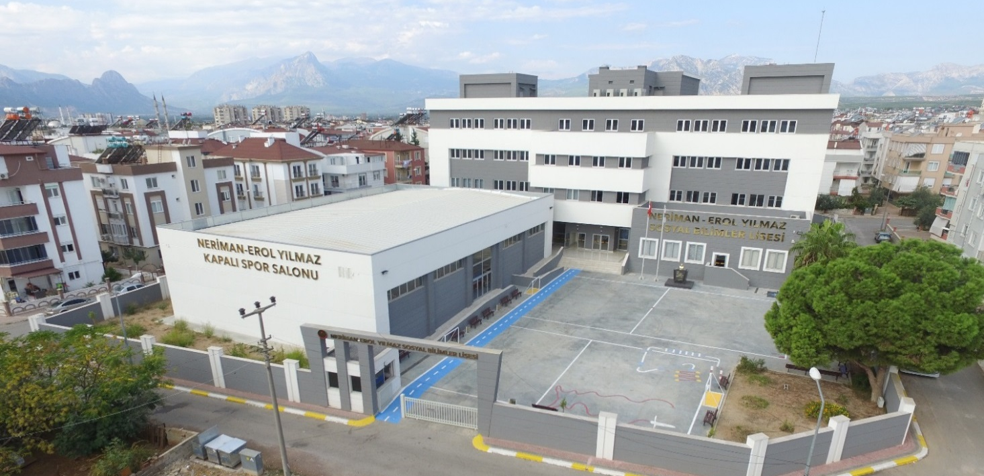
HIGH SCHOOL
A total of 376 (137 PRIVATE) students In our school, 5.906 classrooms, 118.218 students and 10.543 teachers
The number of students per classroom In secondary educatIon Is 20 and the overall schoolIng rate Is 88.98%.

Slide 9
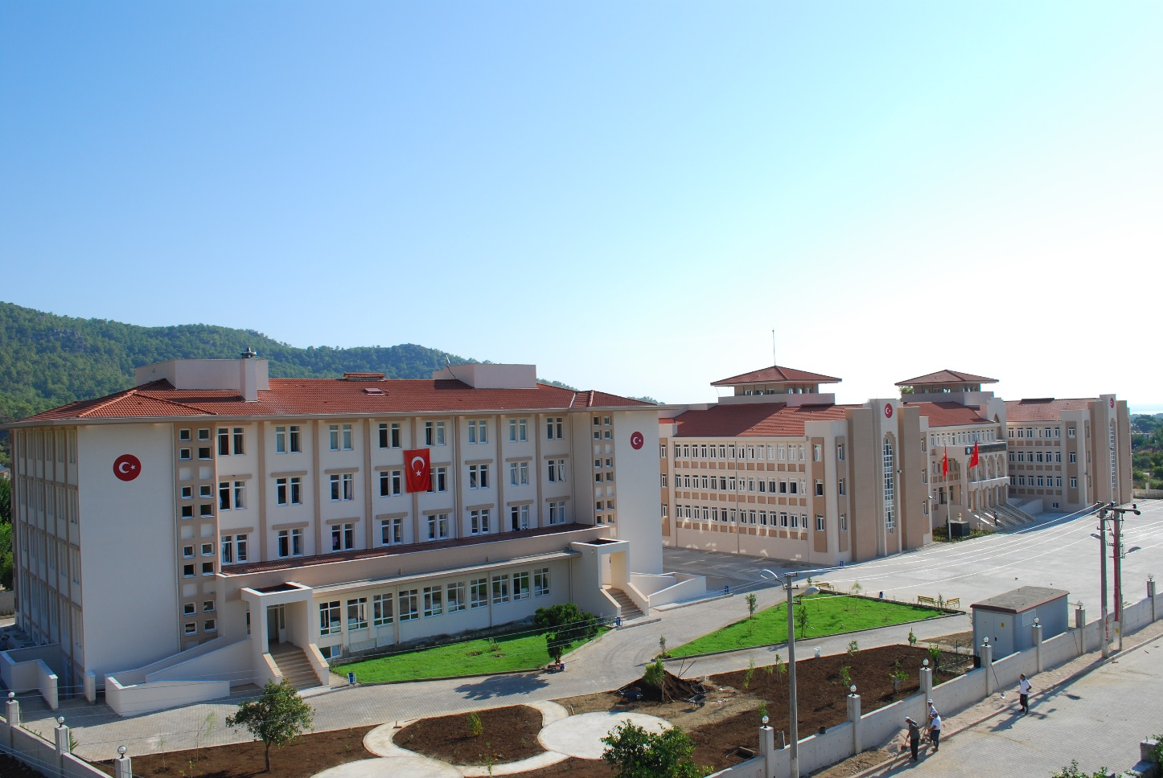
HIGH SCHOOL
Across the province;
11 Science High School, 2 Fine Arts High School,
2 Maritime Anatolian Vocational High School,
3 Sports High School, 4 High School of Social Sciences
3 Science&Art Centers.

Slide 10
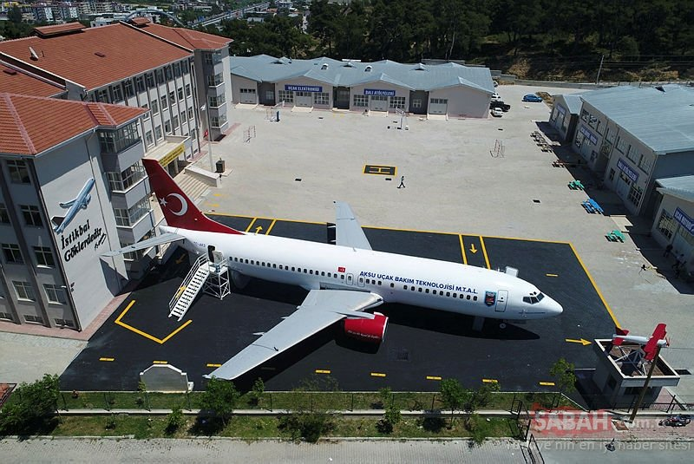
VOCATIONAL TRAINING
In 2003, the number of vocational high schools was 38 (11 of which were private). 42,881 students are studying in these schools.
A total of 2,284 apprentices and 3,178 non-trainees receive training at our 11 Vocational Training Centers throughout the province.

Slide 11
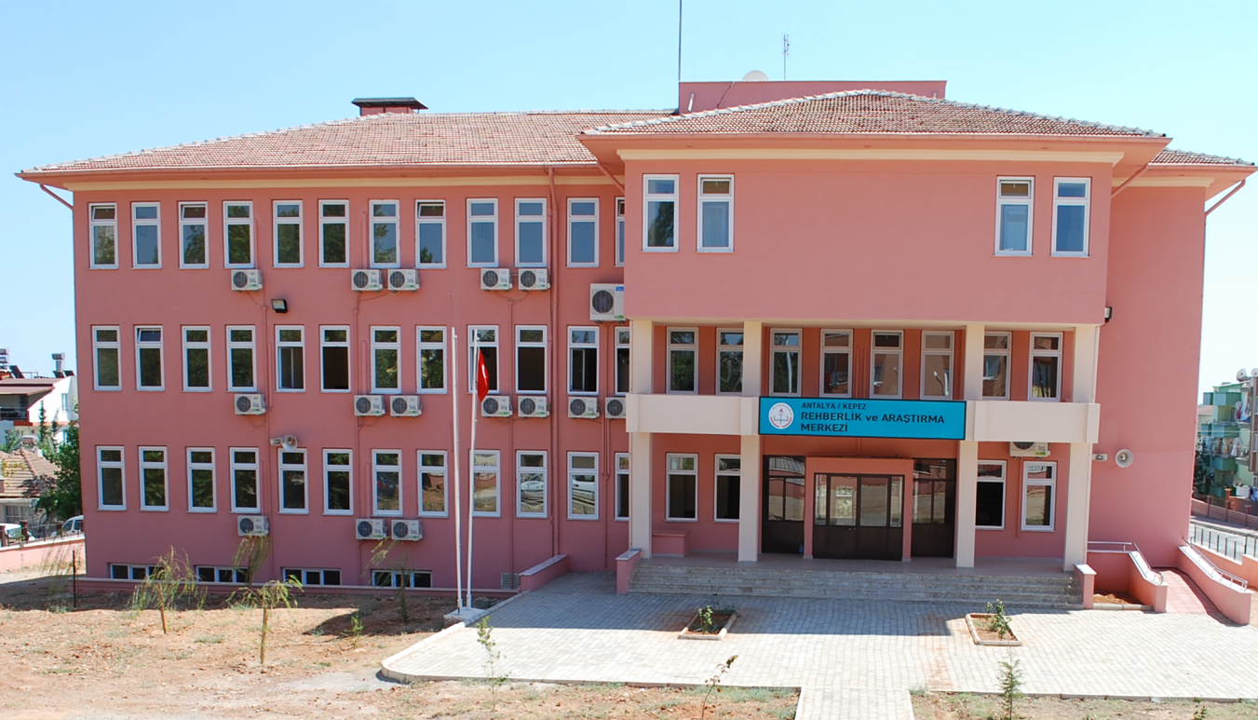
SPECIAL EDUCATION AND GUIDANCE
There are 7 guidance research center , 3 Science Art Centers, 24 of which are official, 3 of which are private, and there are 27 Special Education Schools and 36 Special Education and Rehabilitation Centers throughout the province.
194 students are provided with "Home Education" service.
A total of 5,126 disabled students receive "Inclusive Education" in the normal class.

Slide 12
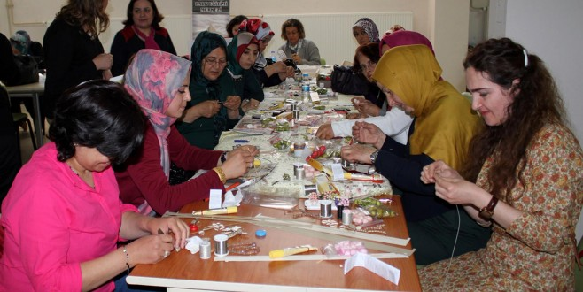
LIFELONG LEARNING
There are 1 maturation institutes and 20 public education centers in our city.
Between 2017-2018 in our city 84.249 women and 54.320 men
a total of 138,569 people participated in these courses.75,575 people received certificates

Slide 13
PROJECTS BY OUR DIRECTORATE

Slide 14

PRIMARY AND HIGH SCHOOL SUCCESS INCREASE PROJECT
2013-MONE INNOVATION AWARDS TURKEY 2nd Place
« VISION MANAGEMENT, STRONG INSTITUTION » PERFORMANCE MANAGEMENT
2015-MONE INNOVATION AWARDS TURKEY 1st Place
«In Charity Work Who Race»
2015-MONE INNOVATION AWARDS TURKEY 1st Place

Slide 15
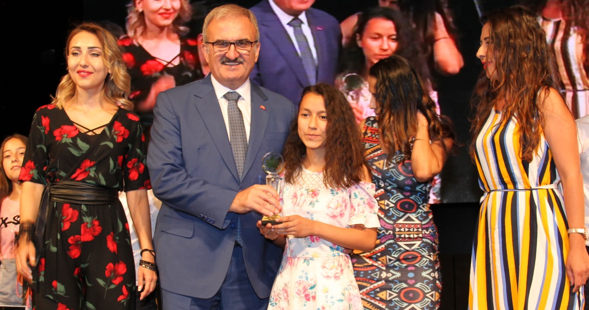
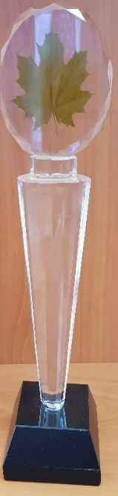
SHORT FILM COMPETITION

