Slide 1
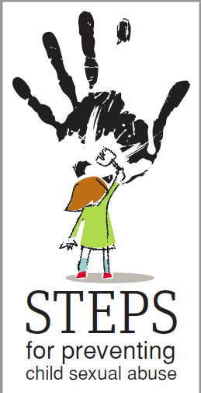





Good examples of precaution methods of child sexual abuse in Latvia
17.06.2019.,
Antalya,Turkey

Slide 2
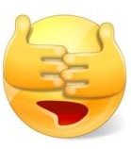
European Council published alarming statistics that show that every fifth child in Europe is a victim of sexual violence.
Many parents don’t educate their children in this area because they don’t realise the dangers, have limited access to information and they don’t know how to talk with their children about sexuality and abuse.

Slide 3
The definitions of violence against children in Latvian legislation - the Law on the Protection of Children's Rights and the Criminal Law
In the legal framework of the Republic of Latvia violence against children is defined in the section "Terms used in the law" of the Law on the Protection of the Children's Rights.

Slide 4
The definitions of violence against children in Latvian legislation - the Law on the Protection of Children's Rights and the Criminal Law
The offenses related to sexual violence that are punishable in Latvia are determined by Chapter XVI of the Criminal Law "Criminal Offences against Morality and Sexual Inviolability".

Slide 5

Institutional cooperation in case of sexual violence

Slide 6

Who can initiate an interinstitutional meeting?
Cabinet of Ministers Regulation No. 545 (12.09.2017.) «On the Institutional Cooperation in the Protection of Children’s Rights»
Cooperation group is an advisory collegial body established by the municipality and its operational territory is the administrative territory of the city in question.
Apmācību programma «Par starpinstitucionālo sadarbību seksuālās vardarbības pret bērnu gadījumu izmeklēšanā», Nodibinājums “Centrs Dardedze”, 2019.

Slide 7
The cooperation group should include representatives from:
Municipal Social Service
Municipal Educational Institution or Educational Specialist
Orphan’s Court
Municipal Police or State Police
Apmācību programma «Par starpinstitucionālo sadarbību seksuālās vardarbības pret bērnu gadījumu izmeklēšanā»,
Nodibinājums “Centrs Dardedze”, 2019.

Slide 8

Booklet «Step by step: Interrogation of a child involved in Criminal Procedure»
The guidelines of the interrogation of child victims and witnesses were developed on the basis of the Investigative Interview Protocol made by USA National Institute of Child Health and Human Development.

Slide 9

Center «Dardedze»
is a Latvian non-governmental, non-profit organization that advocates for childhood free from abuse. It’s goal is to prevent child abuse and provide help to children abused physically, emotionally, sexually or being neglected. The organization has been active since 2001.

Slide 10
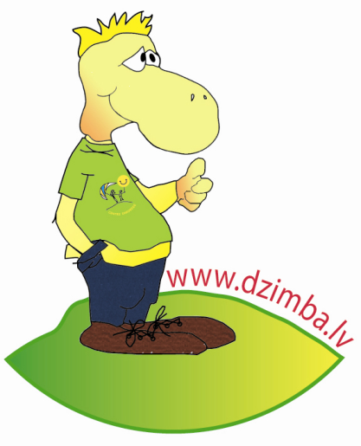
«Dzimba safety program»
Dzimba Safety program is child focused program for reducing child victimization.
The goals of the program are:

Slide 11
Types of sexual abuse
Sexual contact
Touching a child’s body parts
Violation of a child’s privacy
Exposure of a child to adult sexuality
Sexual exploitation of a child.

Slide 12
Educating children on how to avoid sexual abuse
51%
93%
46%

Slide 13

How to protect a child from sexual abuse?
Coded names or passwords
A child can draw parents attention by using a «password» he/she has chosen. Parents should tell children about the situations where a particular word could be used to protect themselves.
http://www.dzimba.lv/skolotaju_stundina/skolotaju_stundina.pdf

Slide 14
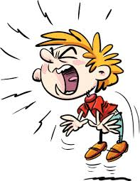
How to protect a child from sexual abuse?
Scream and tell.
Educate a child about the self-defence types, such as the loud scream which can be used in dangerous situations. It is important that parents identify and show the child who are the adults to whom a child can go for a help.
http://www.dzimba.lv/skolotaju_stundina/skolotaju_stundina.pdf

Slide 15
How to protect a child from sexual abuse?
Phone number.
According to the age of the child, he must know the emergency phone number (the parents must try to dial the number in the smart device together with child). The child must know his home address, parents’ phone number.
It is important to remind the information from time to time!
http://www.dzimba.lv/skolotaju_stundina/skolotaju_stundina.pdf

Slide 16
How to protect a child from sexual abuse?
Emergency plan.
The child should be taught about different emergency situations and how to deal with them. He must be told that if a person’s touch is not pleasant and makes him feel uncomfortable it is a dangerous situation, which should be immediately reported to the adult whom the child trusts.
http://www.dzimba.lv/skolotaju_stundina/skolotaju_stundina.pdf

Slide 17
Activity «Touches meant for the whole world»
The child should draw around his hand placed on the piece of paper with a pencil. Invite the children to draw an eye in the middle.

Slide 18
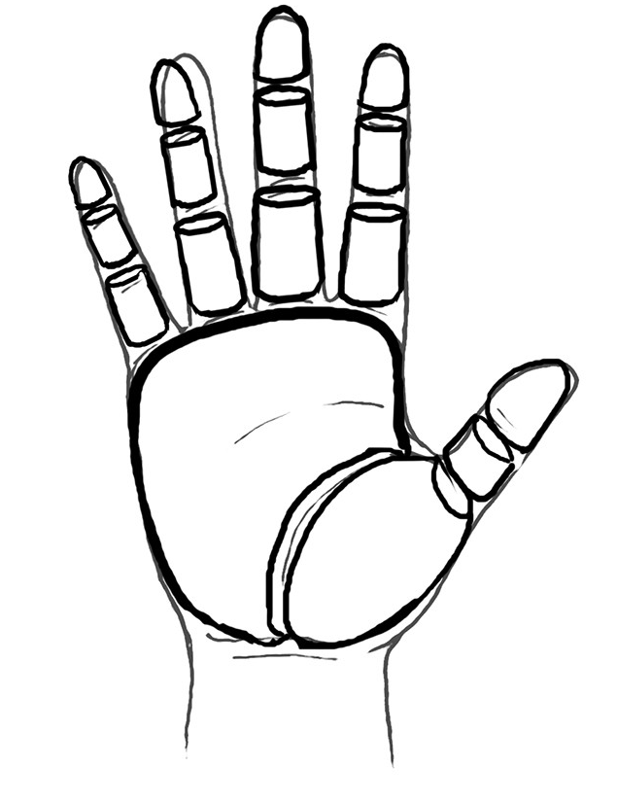

Slide 19
Questions?

Slide 20
Thank you for your attention!

