Slide 1
ERASMUS+2018-1-TR-KA201-058001 «SMART STEPS FOR PREVENTING CHILD SEXUAL ABUSE» TRAINIG OF TRAINERS TURKEY 17-21 JUNE 2019

Slide 2
ICE BREAKING ACTIVITY
MEETING
Presenter sits on the floor with students. He/she shows the ball in his hand and says “kids we are going to play a game together. You see I have a ball in my hand. Now the person I roll the ball towards will say his/her name and roll back me the ball.” Presenter says his name first and rolls the ball to the pupils. Each student says his/ her name and rolls the ball back to the practitioner. Practice will end after every pupil says his/ her name.

Slide 3
PREPARATION TASK
Group Rules
The group sits in a u shape with a table in front of them.
“kids we are going to do same activities together. We need some rules to do them in a peaceful atmosphere. What can they be?” After the answers gathered;
These rules are repeated by pupils «We obey these rules altogether»

Slide 4
We don’t make noise.

Slide 5
We don’t speak without permission

Slide 6



We listen to our friends.

Slide 7


We participate the activities.

Slide 8
PRIVACY EDUCATION IN PRESCHOOL EDUCATION
“Guess what are these differences?” (If the sex differences are said, the slide will continue.)
Discovering the body
What are the differences between boys and girls?
let’s say a difference one by one.” answers from students are gathered. Presenter encourages pupils
“girls and boys are common in many dimensions . But there are some basic bodily differences”;
“Guess what are these differences?”
(If the sex differences are said, the slide will continue.)

Slide 9
PRIVACY EDUCATION IN PRESCHOOL EDUCATION
The human body will be presented on the slayt. “Yes kids, as you can see, we all have eyes, ears, mouth, nose, arm, leg, hand, foot.. Apart from each other, girls have vaginas, boys have penis.”. used Local terms are not used .

Slide 10
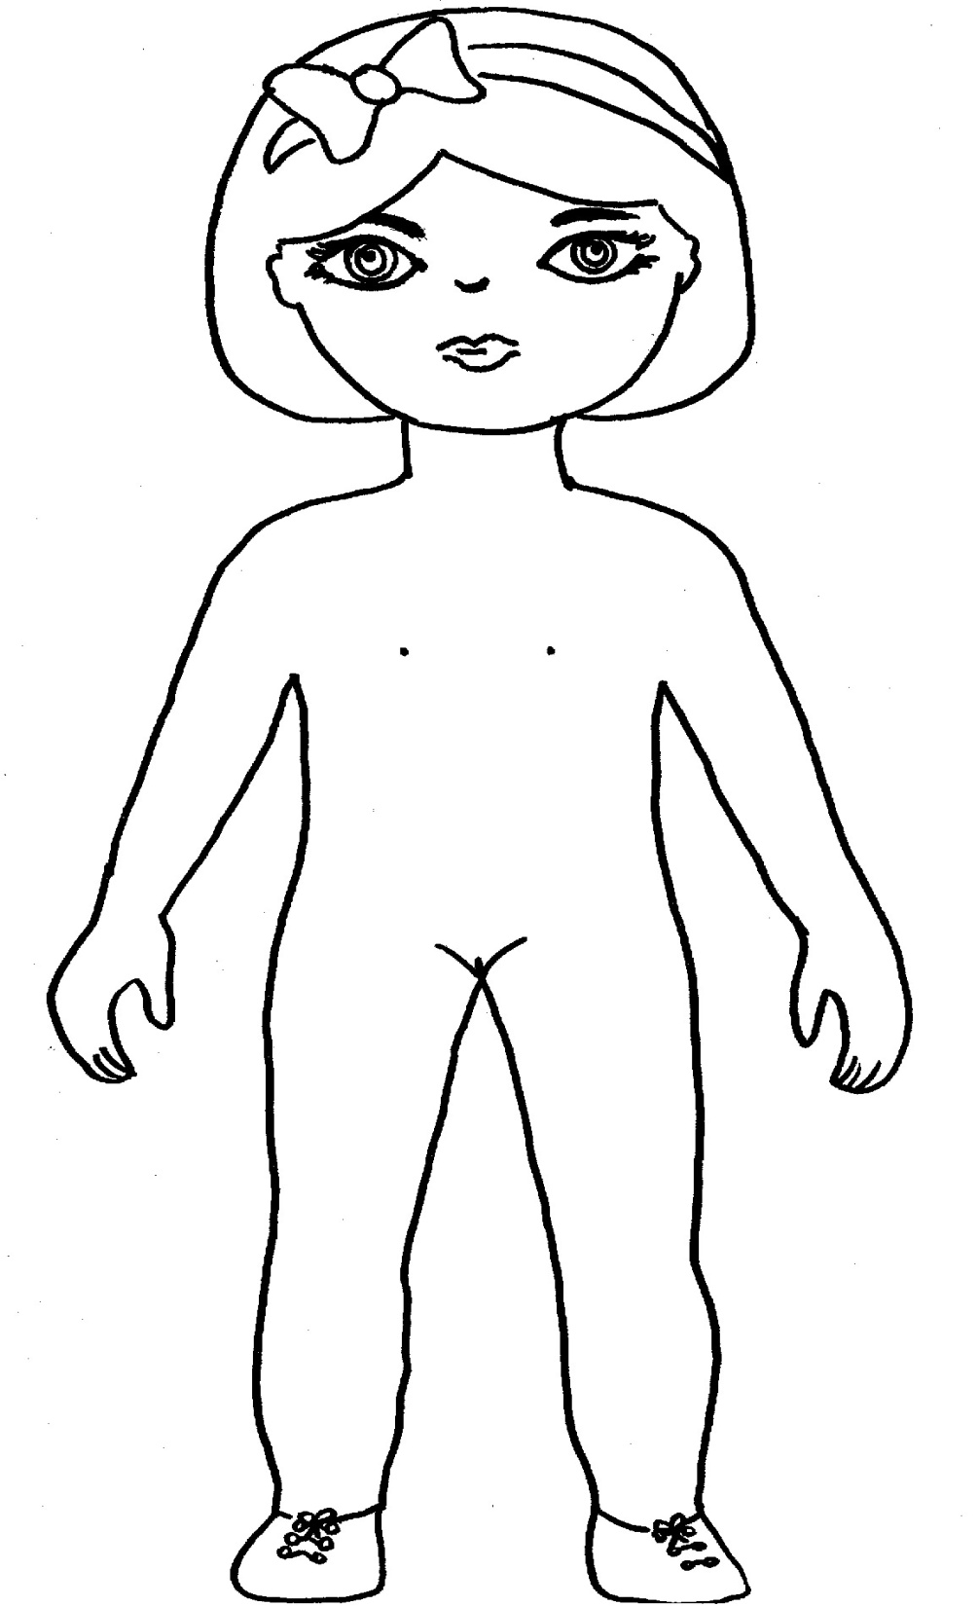
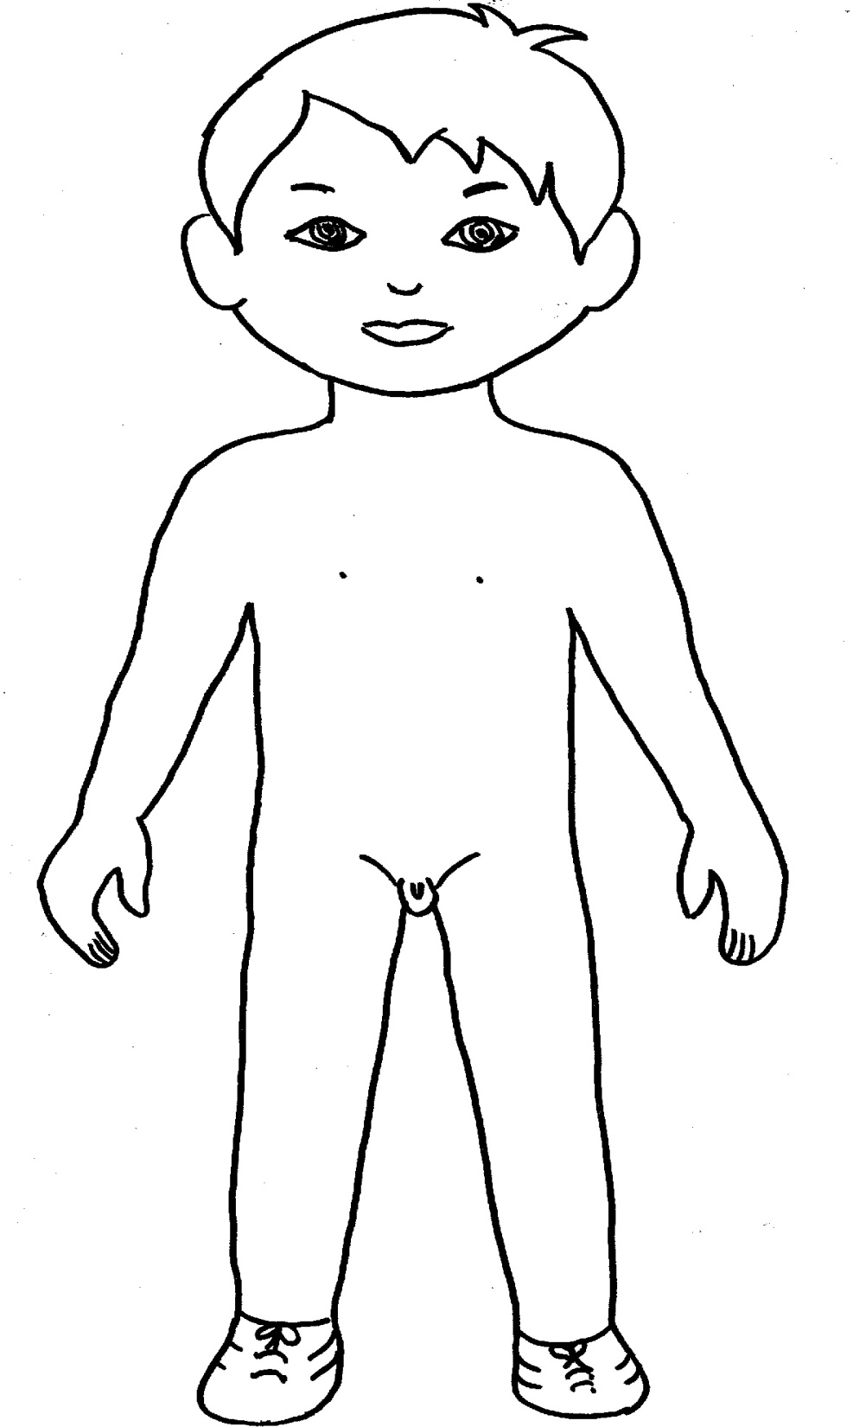
eyes
ears
Nose
Mouth
Breast
Arm
Foot
hand
Leg
Vagina
Penis

Slide 11
“Kids, our breasts, legs and our buttocks are our special areas.” Previously prepared and crafted paper babies and their clothes are distributed according to their sex. atch1(a-b-c-d) “Dress up the clothes for the special areas of babies, than stick them . Let’s color the clothes of the baby. Let the pupil color the body of the babies if they want. Do not collect the babies after the application.

Slide 12

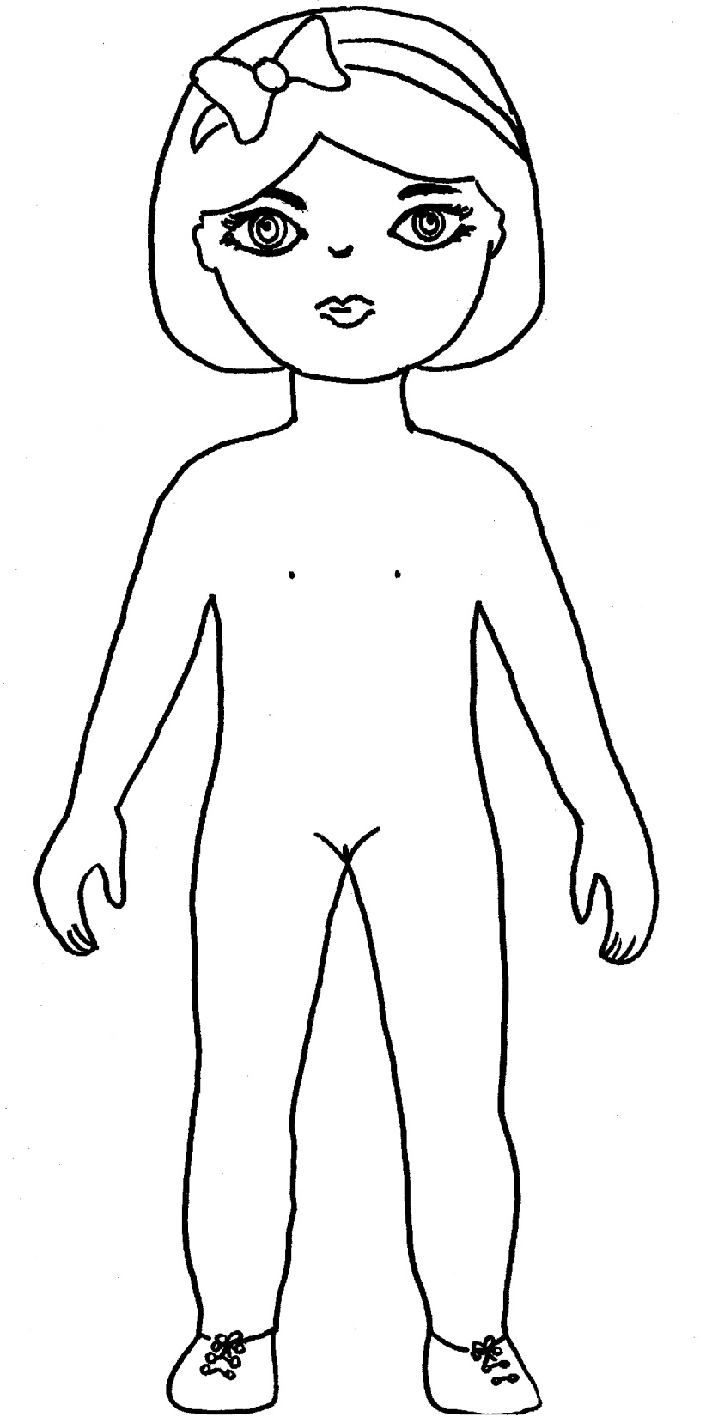

Slide 13
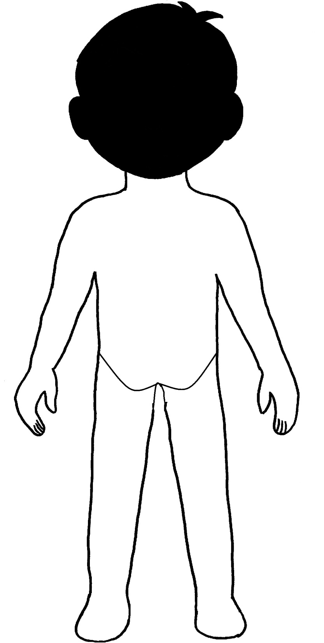
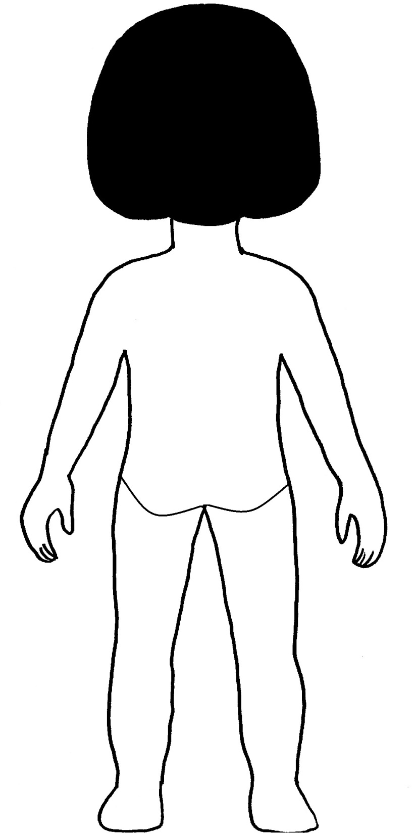

Slide 14
After everybody finishes the presenter says
“No one should touch the special areas where children wear clothes. But sometimes when your parents and people they allow may touch special areas to help you while you dress up or you're in the bathroom. Presenter asks
”You also have a special area that is not covered by clothes, do you know where this is? After the answers , presenter points to the lips and says
“They are lips” “Children should not be kissed from their lips. You have learned nobody can kiss you on your lips. Please also share this information with your parents.»

Slide 15
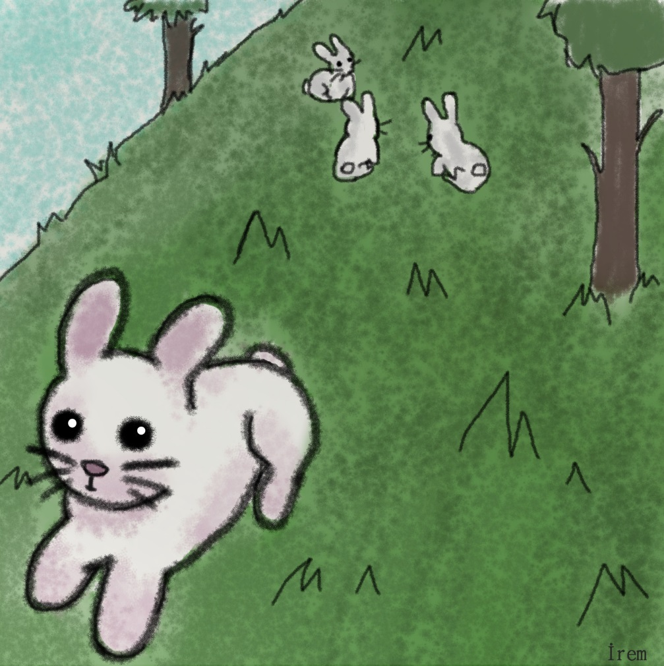
THE FARRY TALE OF BUNNY AND TRAITOR WOLF
One day little bunny went out to play outside. While playing , he went further from his friends.

Slide 16
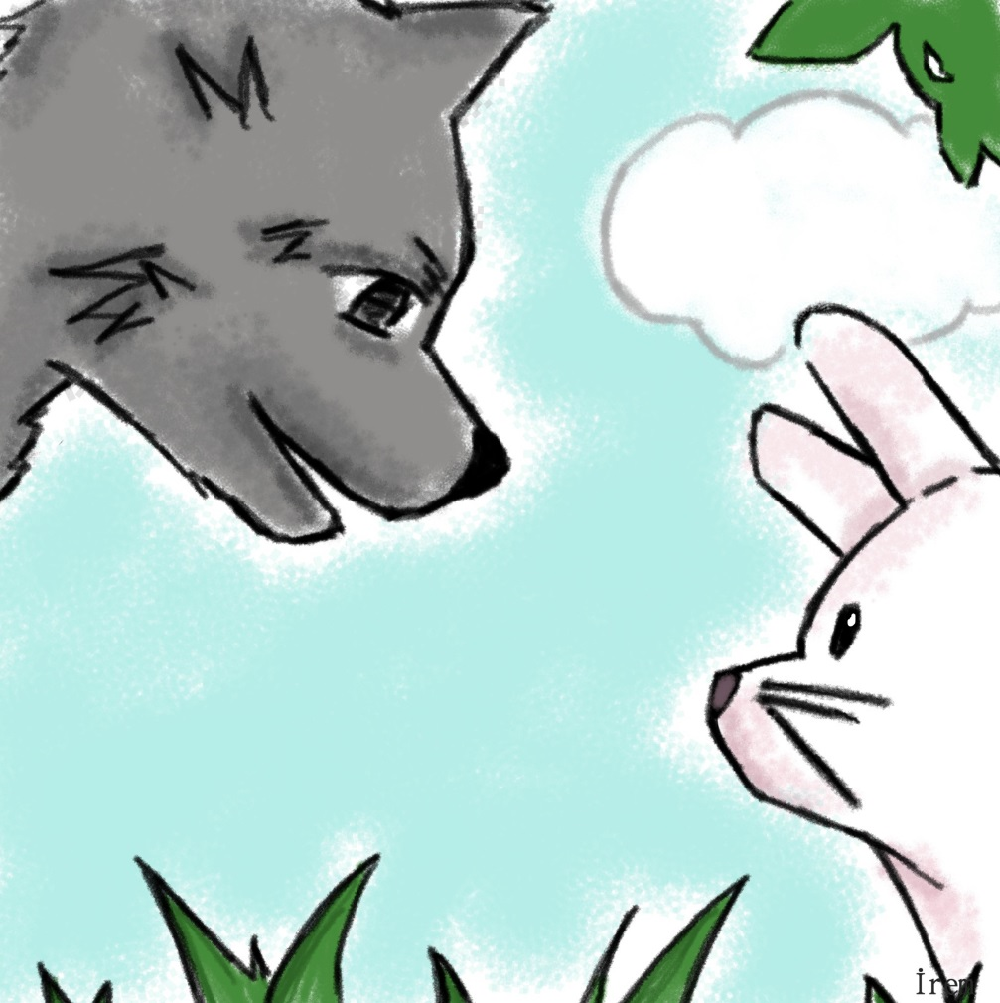
Seeing him alone a wolf approached.
- “Ooooh Little bunny How are you? What are you doing here on your own? Let’s walk around together” the wolf said.
Little bunny was afraid a bit at the beginning but later,
- “Ok” he said.

Slide 17
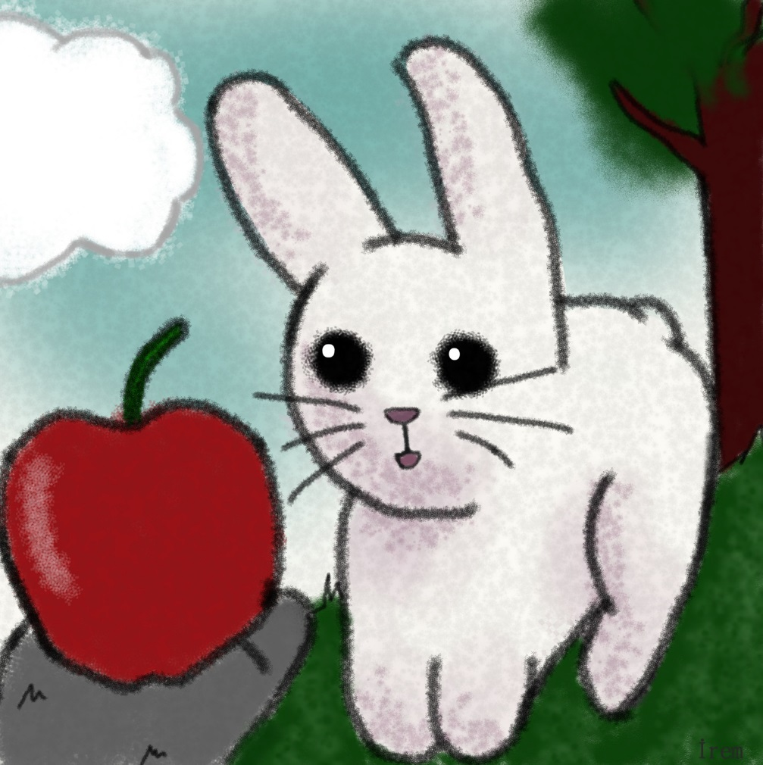
The wolf was very happy to hear that and gave him an apple.
-“come on take this apple , you should be hungry” the wolf said.

Slide 18
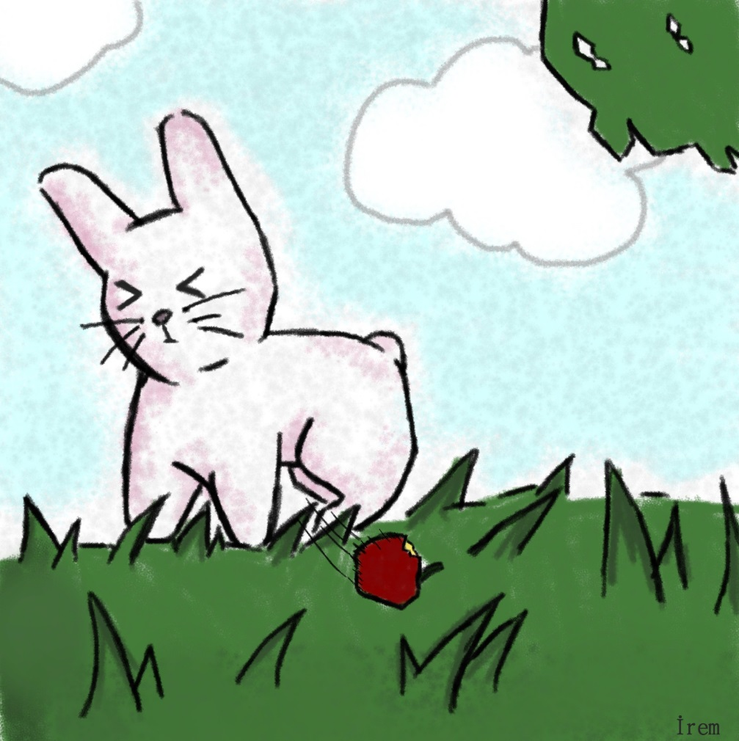
Little bunny took the apple and stared to eat it. While the wolf wanted to hold his hand the bunny felt very nervous. Because his mom always said it was wrong to touch somebody that he didn’t know. Suddenly he remembered not to take anything from strangers. He throwed the apple immediately.

Slide 19
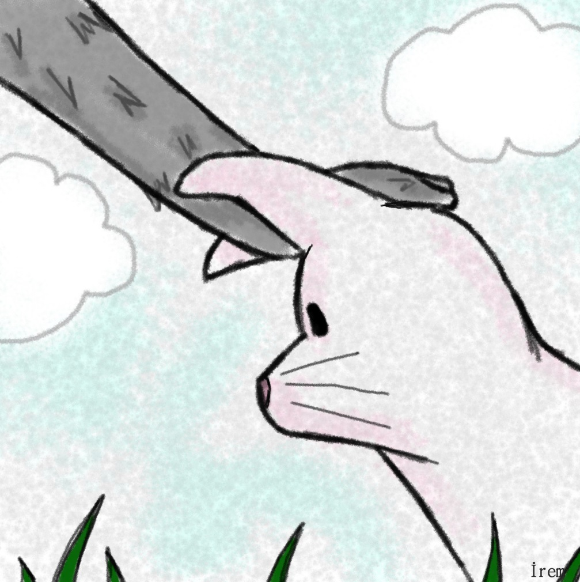
Patting on his head the wolf said
-“How smart you are” and went on tricking him

Slide 20
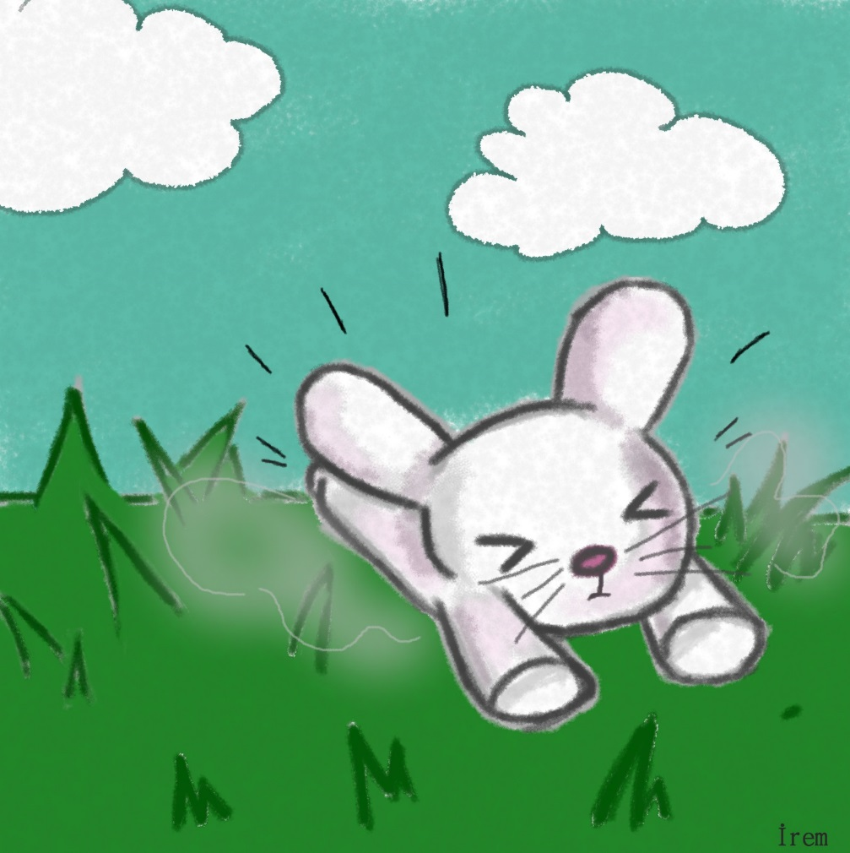
Frightened by the wolf’s behaviors, little bunny started to run away but on the way he fell off.

Slide 21
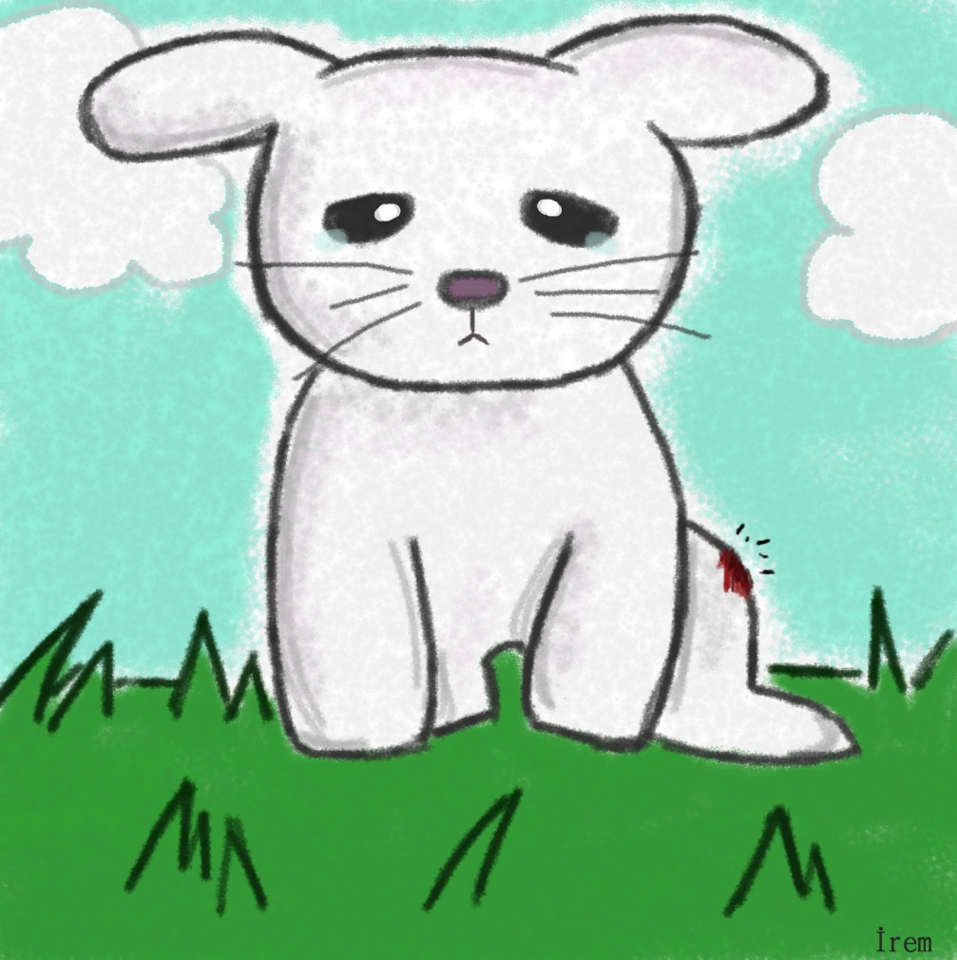
Approaching behind him the wolf said
-» What happened darling, I just loved you very much»
The wolf bended and tried to help the bunny. Irritating by the touch of the wolf the bunny said angrily-“No ! I can do this on my own”. While standing up he discovered that he had hurt his leg.

Slide 22
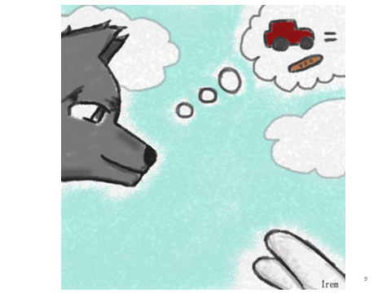
The wolf said
Look little bunny. You have hurt yourself. Let me take you to my house and take care of you

Slide 23
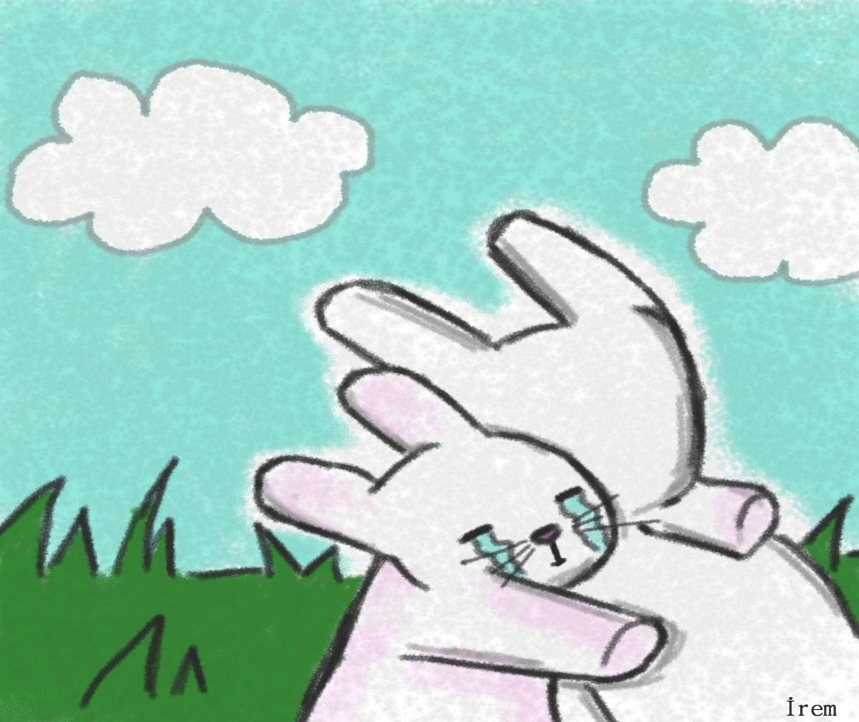
Little bunny was afraid and also his leg hurt a lot. Meanwhile the little bunny saw his elder brother. The elder bunny was worried about little bunny. They run towards to each other and held tightly.

Slide 24
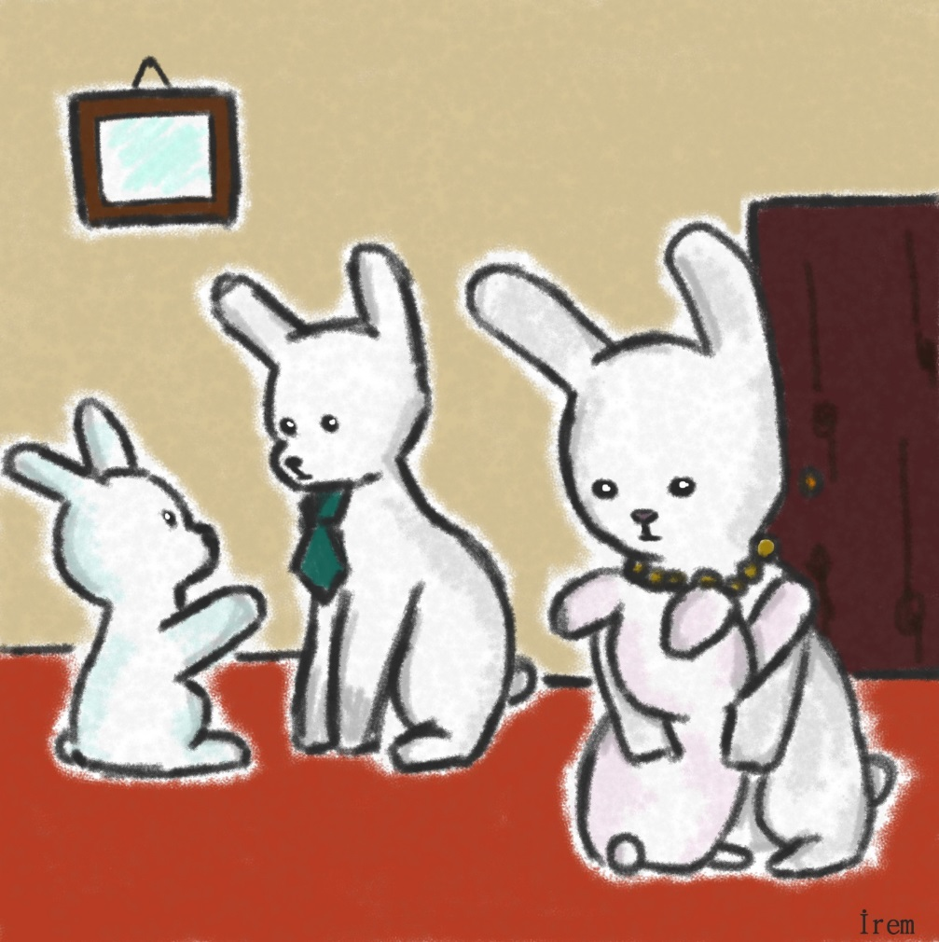
. While they were holding each other the wolf took his car and run away. Bunnies turned back their home and told every thing to their parents. Their parents held them and make them calm down. After that while the mummy bunny was taking little bunny to shower,

Slide 25
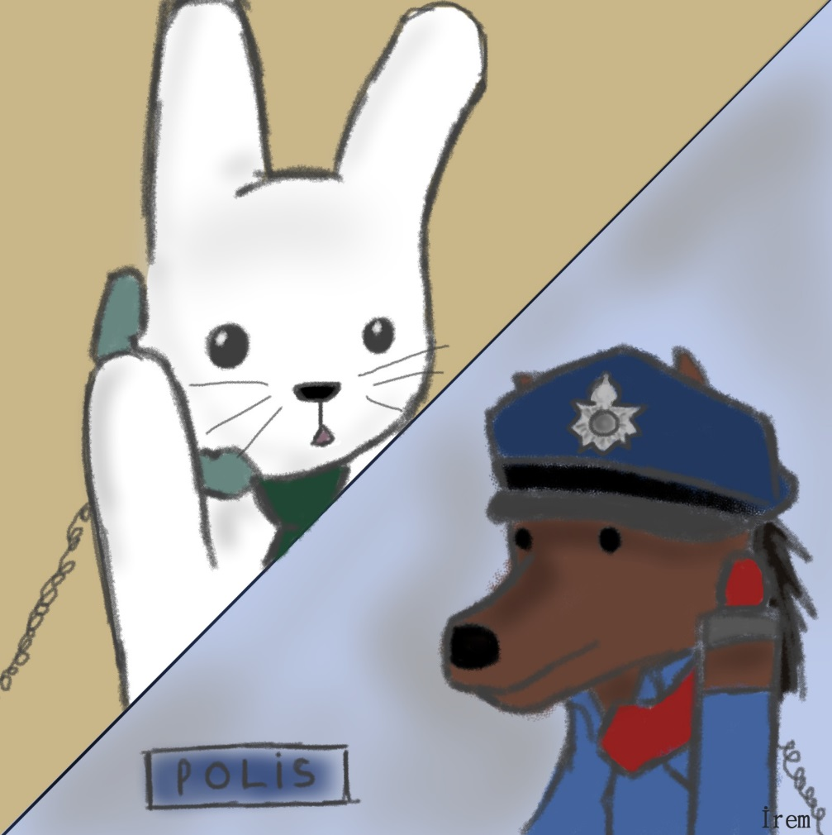
Daddy bunny called the police and warned them about the wolf walking around and trying to trick little bunnies. The police found the wolf and arrested it not to these again

Slide 26
After reading the text, « ok kids you have listened to the story. Now we let’s answer the questions. Questions below are asked to the pupils.
“What did the wolf give to bunny to eat?” (apple) after the answers gathered “ok who can give you food?” is asked.
“how did the bunny fell when the wolf wanted to held his hand?” (very bad. Nervous. After the answers “who can hold your hand?”
“what did the wolf when the bunny fell off?” (took him home and took care of ). After the answers “who can help you if you are hurt yourself ?”
“what did the parents do when they listened the story ?” (called the police).

Slide 27
Who can talk with you when you are sad?
Who can kiss you?
Who can clean you?
Who can give you a present?
Whose car can you get on?
after the answers pupils are warned about the strangers .

Slide 28
Song Activity
The song of «I say no» is listened together. When they finish sing together the chorus . The activity willl go on till every pupil can sing the chorus.

