Slide 1
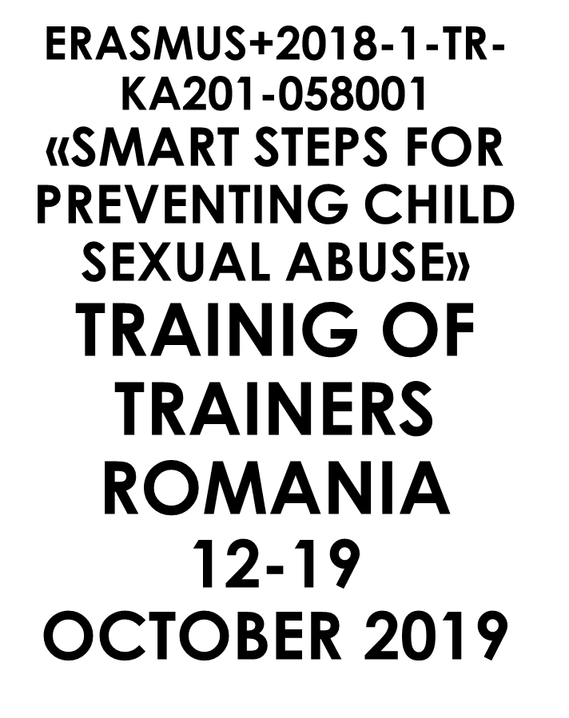

Slide 2
CHILD SEXUAL ABUSE
- CASE STUDY -
Ionela-Cristina GLONŢ
Teacher, school councelor
C.J.R.A.E. Vâlcea
"Anton Pann“ Secondary School

Slide 3
Table of contents
Introduction
Chapter 1. Basic theoretical knowledge
Chapter 2. Detailed information an the case. Presentation
Chapter 3. Aims and objectives of the study
Chapter 4. Research methodology
Chapter 5. Results and interpretation of reserch
Chapter 6. Specific recommendations for the study. Action plan
Chapter 7. Resesarch. Comparisons with other similar cases, relevant to the chosen topic
Chapter 8. Conclusions and the implications of research in psychological practice
Chapter 9. Suggestions
Chapter 10. Summary
Bibliography

Slide 4
Introduction
...„You cannot forget it, you cannot erase it, but you can change your attitude!”
Violence against children and against women has been and still is a problem for most countries. This was observed in a 2014 global study by UNICEF "Hidden in Plain Sight: A statistical analysis of violence against children" in which there are over 190 countries.
Unfortunately, in Romania, we are witnessing an increase in abuse, through the media we can see that the number of sexual offenses involving children, as well as the diversification of the forms of abuse against children are increasing.
The purpose of this study is to identify the consequences of sexual abuse on the psycho-emotional development and integrity of a child.

Slide 5
Possible consequences of the abuse
Numerous research shows that child sexual abuse is consistently correlated with a variety of negative pre-adolescent (Friedrich, 2001; Trickett, 2011) and adolescent (Beeb, 2002) attitudes and negative sexual behaviors.
Recent research notifies the existence of the link between sexual abuse in childhood and the consequences on sexual health at maturity.
Victims of abuse face various disorders, such as: sexual dysfunction, confused sexual identity, aversion to sexual intimacy, multiple sexual partners, hyper-emphasis on sexuality, increased risk for repeated sexual victimization. (Vaillancourt-Morel, Marie-Pier - Avoidant and compulsive sexual behavoiurs in male and female survivors of childhood sexual abuse. Child Abuse and Neglect 40 (2015), pp. 48-59

Slide 6
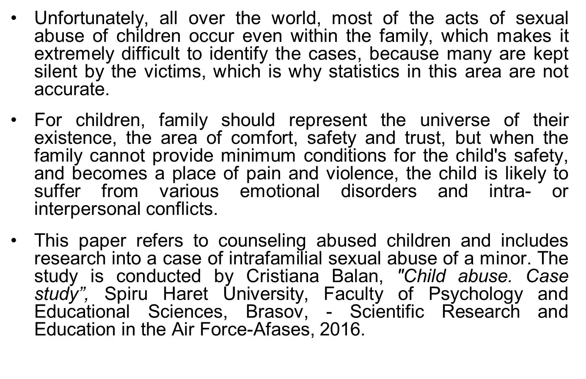
The place where the child should be the safest...

Slide 7

Chapter 1: Basic Theoretical Notions
The Council of Europe defines child sexual abuse as :
a) the involvement in a sexual activity of a child who, according to the national law, did not reach the legal age for the sexual life
b) involving the child in sexual activities, using coercion, force or threats, abusing a position recognized as trustworthy, authoritative or influential on the child, within the family, or abusing a situation of special vulnerability of the child, caused mainly by a mental / physical disability or addictive situations. (Council of Europe Convention for the Protection of Children from Sexual Exploitation and Sexual Abuse, Article 18.)

Slide 8

According to the WHO, child sexual abuse is defined as "the involvement of the child in a sexual activity that he or she does not fully understand and is incapable of knowing, by virtue of the degree of development, being also a violation of social laws and taboos. "
Children can be sexually abused by adults or other children, who, according to their age or developmental stage, are in a position of responsibility, trust or power towards the victim.

Slide 9

What does specialized literature say?
In the specialized literature there is a classification of
relations between the victim and the aggressor.
Within the abuse there may be relationships of authority or trust, and these can be found in several environments, such as:
1. intrafamilial - there may be sexual actions by close relatives (parents, grandparents, brothers, uncles, aunts, cousins) - incest; from persons who substitute parents (guardians, adoptive parents) or perform parental functions (step-parent, concubine);
2. extrafamilial -actions of a sexual nature by persons well known to the child, who, in time, can position themselves as "trusted persons" (teacher, family friend, nanny, neighbor, etc.);
3. Street environment - sexual actions by foreign or lesser known persons, usually with the application of physical violence and threats;
4. Institutional - actions of a sexual nature produced in residential institutions or other institutions that take place, especially between children with the purpose of asserting power, control and hierarchy in the group. (Simboteanu, 2016).

Slide 10
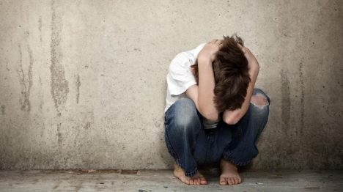
Regardless of the forms in which it manifests, child sexual abuse has multiple traumatic effects on children, both in the short and long term, visible even in future development as an adult..

Slide 11
What research shows
Specialized research shows that, in the case of people who have been abused in childhood:
- sexual abusers, most commonly, were men (known persons, including, child's trust (biological father, mother's concubine, guardian, uncle, cousin, etc.).
- a significant part of the cases of sexual abuse during childhood counseled by specialists reflects sexual abuse for a long period (1-8 years).
the atmosphere in the child's family was deficient, there were conflicting situations, the parents consumed alcohol and often the child was neglected and physically abused.
- in many cases there is a deficient relationship, lack of attachment, between the mother and the abused child.
- In many cases sexual abuse occurs after the migration to work of one of the parents or of both parents.

Slide 12
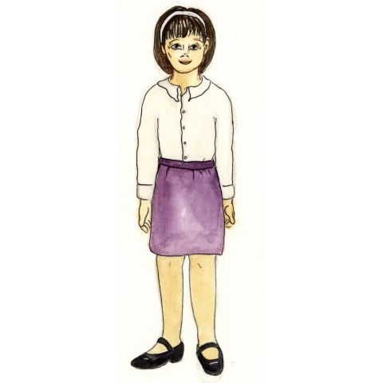
Chapter 2. Detailed information on the case. Presentation.
Daria, is a 15 year old girl, who is under the protection measure at the D.G.A.S.P.C. (General Directorate of Child Assistance and Protection) Brasov, because in December 2015 she was the victim of sexual abuse, the aggressor being her own uncle.
When she was asked about the event, Daria initially refused to tell, but later, with the support of a psychologist from the center, she opened up and started to talk about the particularly difficult moments she had gone through and the acts she had been subjected to.
At the beginning, the girl repeatedly said that her mother knew nothing. The recount of the facts began with the day of the rape, of which he spoke hastily, of the effect that the rape had on her, and of hospitalization and institutionalization.
Daria also states that one day, when "I was losing a lot of blood ... my mother washed me and told G. (the rapist uncle) that he would take me to the hospital the next day ..."
Daria, 15 years old

Slide 13
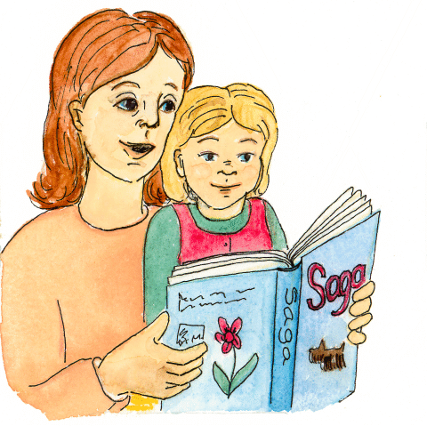
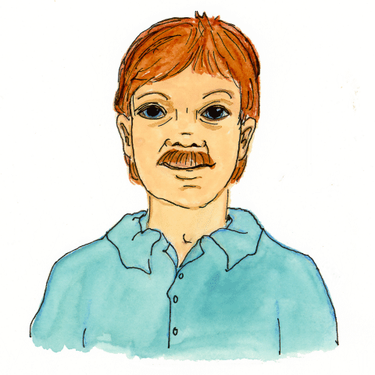
People involved
Daria,
15 years old, victim of sexual abuse
She has been exposed to many
traumatic and critical situations.
Has depressive states, anxiety, low
self-image, emotional disorders,
relationship problems,
regressive behavior, etc.
She was taken and is in the hospital in a
Placement Center She is included
in an intensive program
of psychological counseling.
Mother
-there have been identified
cases of child-neglect by the
mother
-after the daughter was taken
under protection by DGASPC,
the mother‘s visits were
limited.
“I was losing a lot of blood…
My mother washed me and
told G (the rapist uncle)
that she would take me
to hospital"
Uncle
- Sexual abuser
-the girl speaks hastily
about him, trying to
quickly end the discussion
Suspect of several
rape attempts on the girl
The girl has been exposed to numerous traumatic situations
and often negleced by her mother.

Slide 14
Because during the psychological evaluation it was found that Daria was exposed to numerous traumatic and critical situations, and was exposed to situations of neglect by her mother, it was considered important and urgent to keep the child in a safe environment for a period of time, and the mother's visits should be limited.
During the discussions with the child, her mood was constant, good, without significant changes.
Also, given the effects that sexual abuse has on a child's development - depressive states, anxiety, low self-image, emotional disorders, relationship problems, development of inappropriate sexual behavior when the child becomes adult, etc., Daria has had to be included in an intensive psychological counseling program (Balan, 2016).

Slide 15
Chapter 3. Aim and objectives of the study
Aim
Highlighting the psychological impact of sexual abuse on children's development
Objectives
Highlighting the fact that sexual abuse has a psychological impact on the child's behavior, generating a series of negative and regressive behavioral attitudes.
Highlighting the emotional, anxious and depressive states of children subjected to forms of sexual abuse.
Highlighting the hostility of children who have been victims of sexual abuse.

Slide 16
Chapter 4. Methodology of resesarch
The investigated lot
In order to verify the proposed objective, a qualitative research was conducted on a minor, aged 15, who was sexually abused by her uncle.
Research design
Case study - descriptive qualitative research of longitudinal type
Investigation tools
Observation
History
Semi-structured clinical interview
Raven Progressive Matrices
Rey test: perception, attention, memory
Projective techniques (Home test, Person test, Family test)
Case study - descriptive qualitative research of longitudinal type
Working procedure
The discussions with the child and the psychological evaluation took place at the Center for community services in the locality and were conducted in the presence of a psychologist.
In 2015 (immediately after the abuse) the first contact with the child took place to carry out the psychological evaluation.
Daria had a depressive mood, with frequent bouts of crying.
The girl was assured the confidentiality of the data, the observance of the deontological norms of the research, notifying her that the results will be used for scientific purposes and answering all the questions that they have raised, and if she wishes she can withdraw at any time (Balan, 2016 ).

Slide 17
Chapter 5. Research results and their interpretation
Presentation and anlysis of facts. Psychological interpretation of facts.
The analysed criteria were:
General aspects
Visual contact, Communication, Temporal-spatial orientation, Body diagram, Laterality, Psychomotricity and coordination
Cognitive processes
Memory, Language, Thought, Intelligence
Affective processes
Affectivity, Will and motivation, Psychosocial maturation level, Personal autonomy level

Slide 18
C
H
I
L
D
C
H
A
R
A
C
T
E
R
I
S
A
T
I
O
N
Visual contact: The girl establishes a good contact with the evaluator, building a good therapeutic relationship, based on trust, security, unconditional acceptance.
Communication: Communicates easily, provides information, helping in the process of data reconstruction.
General
Aspect
Temporal-spatial orientation: She is correctly oriented in time and space, auto- and alopsychic.
Body diagram: The laterality and orientation regarding the body diagram is perceived correctly.
Psychomotricity and coordination: From the point of view of coordination and psychomotricity, the girl does not have any problems.
Memory: The mechanical capacity is low in storing and reproducing information. The memories of the past are evoked with a slight hesitation or they are repetitive, being defense mechanisms caused by the emotional traumas suffered.
Language - without developmental disorders, but presents a poor vocabulary, under chronological age. Graphic language and language creativity are deficient. Facial expression and posture are consistent with the emotional state.
Psychological point - Cognitive processes
Thinking - the stage that D. has acquired is that of the concrete operations, a slow operation is observed, the mathematical calculation is made with difficulty.
Intelligence - the intellect is weak (at the border with the liminal intellect) based on the lack of age-appropriate stimulation: IQ = 80, VM = 7 years and 8 months, perfectable (the result is obtained when the girl was 11 years old).

Slide 19
C
H
I
L
D
C
H
A
R
A
C
T
E
R
I
S
A
T
I
O
N
Affectivity - shows mixed emotional disorder with anxiety-depressive elements and maladaptation, post-traumatic. It presents an increased emotional instability, low resistance to frustration, crying easily, being easily influenced.
There were identified states of anger or fear when faced with the memory of abuse or after exposure to sexual accusations.
Severe disturbance of mood or emotions (for example, had long and frequent periods of depression, irritability, anxiety).
Occurrence of regressive behaviors (for example, thumb sucking, baby language, enuresis).
Increased mistrust of others, manifested through social isolation and difficulty in maintaining close relationships.
Psychic point of view - Affective processes
Will and motivation: The level of will and motivation is high, it needs support / support during the accomplishment of the work tasks.
The level of psychosocial maturation: immaturity, low capacity for integration in society, low adaptability to the new environment, low self-image, interaction problems, development of age-appropriate sexual behavior.
Interpretation of projective tests
The level of personal autonomy: ipresents age-appropriate self-care skills, which she practises in the center, following the limits of the personal space.
Initially, only the parents and one older brother appeared in the family drawing, which indicates that D. has not established a well-mapped place within the family in the mental plan..
Supported by open questions and discussions, the girl is placed in the drawing, next to her mother, which may indicate a relationship of attachment of the child to the mother.
Projective tests and behavioral observations indicate a relationship of attachment of the child to both mother and brother, grandmother, sister, father and child. (Balan, 2016)

Slide 20

Chapter 6. Specific recommendations for the case studied. Action plan
Specific interventions regarding sexual abuse
➢ Individual counseling sessions in order to increase the level of self-confidence. Use of eye contact, active listening, unconditional acceptance, all of which contribute to stimulating self-confidence and ability to identify and verbalize feelings.
➢ Therapy sessions in order to encourage and support the girl, in order to express and clarify feelings related to sexual abuse and to give the child the opportunity to express and focus her feelings.
➢ Use of dolls with anatomical details to allow the child to verbalize and show how she was abused
➢ Advise family members to set limits on family confidentiality.
➢ Identification of all the ways in which the significant members of the family will support the child;
➢ Orientation to a support group, made up of children with similar experiences, to obtain support, to ensure that she is not the only one who has gone through what happened to her;
➢ Psychological evaluation of the child and / or other family members to see if there are severe psychiatric disorders; (Balan, 2016)

Slide 21
The objectives of the therapy
Short-term goals
Full description of the abuse, identifying the nature, frequency and duration of the abuse.
Identify and express feelings of abuse.
Giving up secrecy and informing important family members about abuse. Verbalize how sexual abuse has influenced the life of the victim.
Decrease feelings of shame or guilt and strengthen the belief in the innocence of the victim in relation to sexual abuse.
Stabilizing the emotional state. Support and acceptance from the family, improved socialization and increased number of friendship relationships.
Establishing and accepting the appropriate limits on privacy within the family.
Long-term goals
Stopping any sexual exploitation of children, understanding.
Control of emotions and behavior as a result of solving traumas related to sexual abuse.
The power of the ability to establish and maintain close interpersonal relationships.
Establishing appropriate family limits and general rules to minimize the possibility of future sexual abuse.
Obtaining healing within the family system, evidenced by the verbal expression of forgiveness, the desire to release and overcome the situation, eliminating denial from the girl and family, placing the responsibility for the abuse on the abuser and offering support to the victim.
Building self-esteem and self-confidence by displaying an increased number of positive traits about herself and a wider participation in extracurricular activities (Balan, 2016)

Slide 22
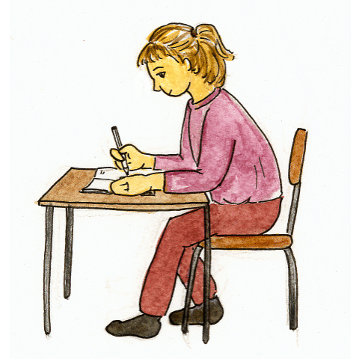
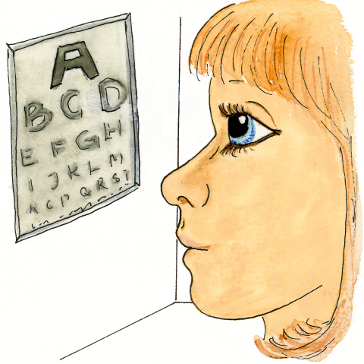
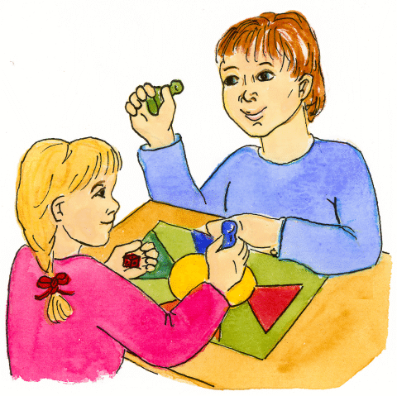
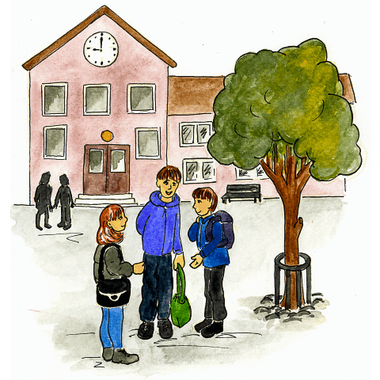
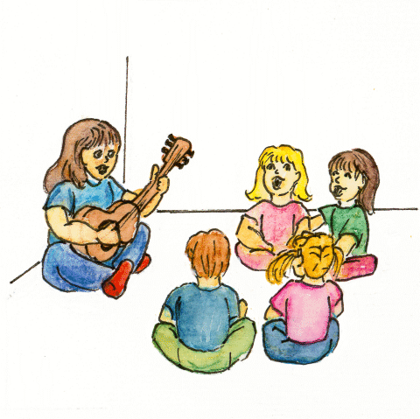
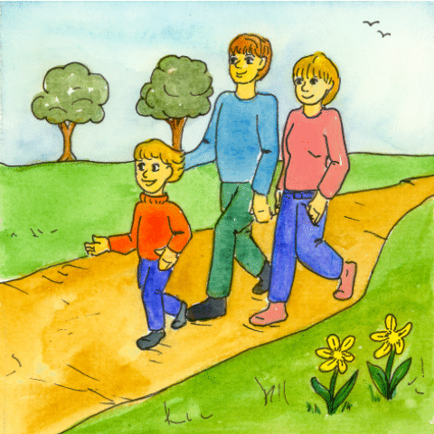
Recommendations
Psychological evaluation
Individual counseling
Group counseling
Psychotherapy
Ludotherapy
Support group
Socialising
Family support
Incresing safety/security feelings

Slide 23
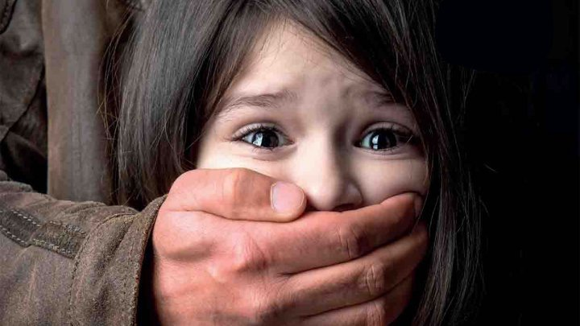
Chapter 7. Research. Comparisons with other similar cases, relevant to the chosen topic
Case1
Sexual abuse by the mother's concubine
(study taken from Sîmboteanu, D., Cheianu-Andrei, D., The correlation between childhood sexual abuse and subsequent risky sexual behavior. Study, National Center for the Prevention of Child Abuse (CNPAC), Realitatea Media, Chisinau, 2016, p. 37, 38)

Slide 24
"I gave counseling to a girl who was sexually abused at 9-10 years old, who contacted me by telephone at 16 and came to counseling. The girl was the victim of sexual abuse by the mother's concubine. She told her mother about the abuse, but that didn't stop her from going to work abroad and leaving her, along with her younger brother, in the care of the sex offender. Obviously, after the mother's departure, the sexual abuse continued ...
So, this girl asked, at 16years old, for a psychological consultation. She began to meet a boy of the same age, it was time to express some tender expressions with erotic touch between them. She agreed, but her reaction was unexpected. She started crying and this scared him.
When we started processing this event, we came to a huge connection gap between her and her mother.
The lack of communication with the mother made her very vulnerable. The girl was open to communication with anyone else and could enter into dubious relationships, be attached to different people. She told me she liked to hear compliments from men, and that made her be open with them.
At 16, the girl got into the situation when she would accept a long-term inappropriate relationship with a person who would abuse her. She is the perfect partner for an abusive relationship. The mother cultivated in her a feeling of inferiority, a feeling of inability, of infantilism. To overcome the problems that have arisen, she needs affection, love, protection. So we have grown-up people, who look good, but who feel incapable and permanently associate with someone, who, in their opinion, are stronger, more authoritarian, abusive. ”

Slide 25
Specialists’ opinion
Specialists point out that sexual abuse during childhood, which has existed for a long time in conjunction with the lack of attachment by a family person, are the factors that favor risky sexual behavior at maturity, sexual dysfunction, relationship disorders, emotional instability, and so on .
The vast majority of the aggressors, in the cases analyzed in this study, are adults. The cases when the aggressors are young people exist, but there are fewer addresses and specialists rarely face them in practice. Such situations occur more frequently in the case of persons with disabilities. Research data allowed to identify cases of sexual abuse in residential institutions for children with disabilities but also for children with disabilities living in families (Simboteanu, 2016, p. 38).

Slide 26
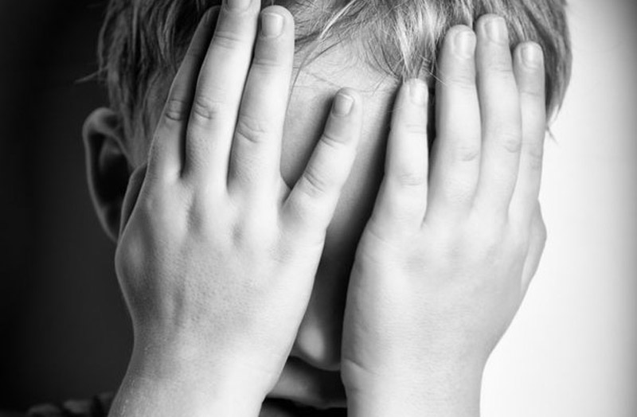
Case 2
A sexually abused boy
"At 16, the boy was abused by an older boy with whom he was friends and who was of another sexual orientation. After this older person established trusting relationships, he violated him. Initially, the abused boy trusted the abuser. He was proud of making friends with an older boy. After the incident, the abuser convinced the victim that everything is fine, as probably he is a similar person ... Respectively, the person addressed the psychologist after 5 years with personal identity problems, including sexual ones. "
The person was in constant search, changing his interests quickly ... In 5 years he had changed 4 faculties. Suffering - could not fiind himself in the profession, in the relationships with girls and boys ... He did not know in which direction to go. He did not know who he was, with whom he could make relationships. ”(Simboteanu, 2016, p. 41)

Slide 27
Chapter 8. Conclusions and implications of research in psychological practice
After analyzing the clinical history and observing the personal evolution of the abused minors, we found an increased prevalence of the comorbidity of the stress disorders with other pathological disorders.
Abuse can be considered an increased risk factor in triggering various disorders or behavioral changes that lead in time to social isolation, hostility, depression, etc.
We observed that in our study, physical, sexual, emotional abuse of the child coexists with the physical, emotional, medical, educational neglect, these methods of maltreatment appear at high levels and are repetitive and require specialized support protection in the trauma of the abused child.
This research draws our attention on the fact that the lack ofaffectivity is also a type of psychological abuse because it expresses the impossibility of establishing the attachment relationship. In psychology it is known that the attachment relationship is very important, being a key factor in the psycho-emotional stability and maturity of a person, contributing to the structure of the child's personality, to the formation of his / her life skills.

Slide 28
Also, the studies have shown that incestuous relationships are kept secret, camouflaged, abusers threatening the victims and forcing them to silence, and even if in a certain context the victims have the opportunity to speak, they are ashamed, they fail to overcome their inhibitions and call for help, remaining alone in the stressful and traumatic situation.
Children's counseling aims to optimize self-awareness and personal development, to remit emotional, cognitive and behavioral problems.
Individual and group psychological counseling of the child or family, informing parents about the possibilities of reintegration into the family environment, the means, methods and techniques of the therapeutic team in implementing recovery programs, awareness of the benefits of continuous activities, are part of the conceptualization of the problems of the beneficiaries and their recovery.
Psychotherapeutic interventions, supportive psychotherapy, psychodrama, integrative therapy, cognitive-behavioral therapy, relaxation methods and techniques are applied depending on the psycho-emotional, relational problem of each child - victim of an abuse.
Children need to be recognized for their values, to be rewarded for their achievements, understood when they are wrong, and they must be helped and supported to find appropriate solutions to the problems they face, in order to become balanced and responsible adults.

Slide 29
Chapter 9. Suggestions and proposals
2. Changing the mentality of the population, there is still discrimination, many children from disadvantaged families do not enjoy the most basic rights: the right to development, the right to education, the right to protection, the right to enjoy social security, the right to protection against abuse of the aggressions regulated by the Romanian Legislation, the UN Convention on the Rights of the Child
3. Training of staff working with children, from a psychological and legal point of view. Preparing teachers, medical staff, social workers, to know how abuse can be identified, what are the measures to be taken.
From the information gathered we realize that there are many neglected aspects, overlooked, accepted passively, but which unconsciously contribute to the continuation of the existence of abusive behaviors of any kind.
Thus, at the end of the paper we will present some suggestions in order to reduce abusive behaviors:
1. Good information of children, people, in general, about the rights of the child and human, and the ways of protection against abuse and neglect. Not all children are fully aware of their rights, many believe that they should be treated like that. The media should promote real information campaigns about combating violence and preventing it, to highlight the consequences of abuse.

Slide 30
4. Establishing at the level of all educational units and public institutions the positions of psychologists and social workers so that the children should know who to talk to and the cases of abuse should be detected early.
5. Providing social services for family and children. Establishment of teams of specialists for intervention, support and education for families who are at risk (families with precarious income, disadvantaged, with departed parents, etc.)
6. Establishment of crisis centers for abused children or families. To avoid the situation of leaving and having no where and thus to leave the abusive environment.
7. Establishment of social housing in each community for poor families and with many children
. 8. Carrying out pro-family and pro-life campaigns that will lead to the improvement of the relations between parents and children, to the increase of the harmony in the family and of the quality of their lifestyle.
9. Providing free counseling and therapy services for the family, child, victims. With the help of these services, the victims feel accepted, they no longer feel alone. Families learn how to interact effectively with their children, learn to listen to what their children need. Children develop emotionally, become aware of the painful experiences they are facing and try to overcome them.

Slide 31
Chapter 10. Summary
As we have seen, sexual abuse is a negative social phenomenon more often than we would like to admit, with shades much more painful than we imagined and takes place among us in the world, both on adults and on children. The forms that sexual abuse takes vary between minor incidents (being expesed to jokes, obscene verbal clichés) and forcing the victim to look at naked people; the obligation to watch with the abuser pornographic images or movies, sexual abuse, including sexual contact, etc.
The psychological development of an abused person is strongly marked by the abuse suffered, and manifests itself at the level of communication, relationship, affectivity and at the intellectual and behavioral level.
The most important support for the child is that of the family; parents play the key role in the child's life and stability, and a low degree of parental involvement represents a risk of neglect or even abuse.
For children, the harmony of the family, the position they occupy in the family, the love, the understanding, the respect and the autonomy granted to them matter much more than the material aspect. Children want to be respected, given the right to opinion, not to be physically or emotionally abused, parents must be understanding and close to them.

Slide 32
If the abuse and neglect had no consequences for the child and would disappear when he became an adult, the situation would only be half solved.
But maltreatment also influences the life of the future adult. The greatest risk in this regard is the perpetuation of abusive behavior.
Thus, abused children can become abusive in their turn. Many of the victims become aggressors. And the most suitable and good solution, both for the society and for the individual is the rehabilitation of the people involved in abuses.
We must remember that each of us can contribute to the improvement of a man's life, as well as to the worsening of his life. Therefore, it is good to realize that we live in a society and that we must do the job of rational people with dignity.

Slide 33
BIBLIOGRAPHY
1. Alexandrescu,G.,(1998, )Poverty and Human Rights, Bucharest, PNUD.
2. Allport, G. W, (1991), ,Structura si dezvoltarea personalitatii, Editura Didactica si Pedagogica, Bucharest.
3. Balan, C., (2016) Child abuse. Case study, Spiru Haret University, Faculty of Psychology and Educational Sciences, Brasov, - Scientific Research and Education in the Air Force-Afases, DOI: 10.19062/2247-3173.2016.18.2.4
4. Ionescu, S., (2001) Copilul maltratat. Evaluare, prevenire, interventie, Editura Fundatia Internationala pentru Copil si familie, Bucharest
5. Sîmboteanu, D., Cheianu-Andrei, D., (2016) Corelatia dintre abuzul sexual în copilărie si comportamentul sexual riscant ulterior. Studiu, Centrul Naţional de Prevenire a Abuzului faţă de Copii (CNPAC), Realitatea Media, Chisinau
6. Vaillancourt-Morel, M-P., at all. (2015) Avoidant and compulsive sexual behavoiurs in male and female survivors of childhood sexual abuse. Child Abuse and Neglect, DOI: 10.1016/j.chiabu.2014.10.024.
7. Cercetare constatativ-ameliorativa. Abuzul asupra copilului - accesata la data: 05.10.2019 http://www.scritub.com/sociologie/asistenta-sociala/CERCETARE-CONSTATATIVAMELIORAT35671.php

