Slide 1
ERASMUS+2018-1-TR-KA201-058001 «SMART STEPS FOR PREVENTING CHILD SEXUAL ABUSE» TRAINIG OF TRAINERS TURKEY 17-21 JUNE 2019

Slide 2
STUDENT SESSIONS II. DAY II. SESSION

Slide 3
II. SESSION
Aims of the session
Achievements
materials
Legal Rights

Slide 4
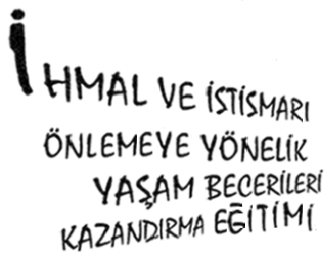

Slide 5
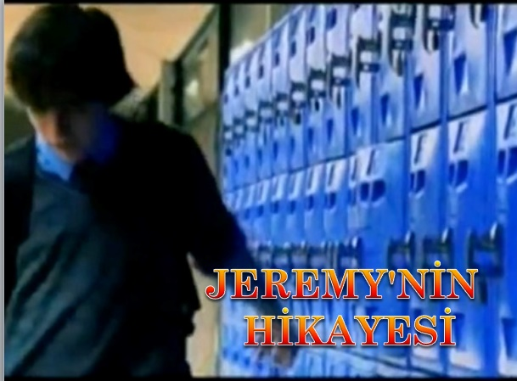

Slide 6
What are the situations that might lead to abuse in the film?
Why wasn’t Jerremy disturbed?
What did it mean that his family didn't neglect Jeremy?
What will happen if Jerrmy’s family have neglected him?

Slide 7
Legal Procedure
In case of any negligence, what should be done is to apply to a reliable adult (mother, father, relative, teacher, etc.) or directly to the public prosecutor and / or law enforcement.

Slide 8
Legal Procedure
Children's Police / Gendarmerie / Prosecutor's Office
Child Monitoring Centre
Court

Slide 9
Legal Procedure
Under the Child Protection Law
Accommodation
education
health
Consultancy
Precautions are taken.

Slide 10
Turkish Panel Law
The penalties given in the case of negligence and abuse in the Turkish Penal Code are explained in Article 102 and 105.

Slide 11
Our Rights
Turkish Panel Law
Child Protection Law
Convention on the Rights of the Child

Slide 12
Activity-1: Silent Movie
Application : Practitioner atch-14 puts the pre-cut phrases in the slogan form into the pouch and gives the students;
«We will play silent movie together. One of our friends will try to describe the Word he take in the bag without talking to you. You can describe the words how ever you want. And others will try to guess what your friend is describing. Who will come first?» and the game starts.
For every slogan students will have 5 minutes.

Slide 13
Activity-1: Silent Movie
Atch-14
Save your body
Say no
Don’t touch, let them touch
You are special protect yourself
Don’t tolerate
Don’t watch, don’t let them watch
Don’t talk your privacy
Don’t touch my body
Don’t keep quite
Check privacy steps
Draw your borders
Don’t be defeated

Slide 14
Activity-1: Silent Movie
Finishing the session:
«We talked with you about the neglect and abuse types, the situations that may be faced, how to protect them . Finally, we have received information about legal rights and responsibilities We talked about the importance of getting to know yourself and your friends and the relationship of trust. First you, then your family and reliable friends to protect you from risks while keeping you safe, in any case you know what to apply now. Thank you for your contribution.

Slide 15
THANK YOU….
PREPARED BY
Meltem ÖKTE ÇIKAN
Ayşe TEKİN ASLANTAŞ
N. Gökçe YILDIRIM

